Slide 1
Statistics and Reliability: Module 12
Weibull Introduction
Notes:
Module Topics
Overview
First Steps from the Weibull++ 7 Software Training Guide (pages 7-14)
Weibull Data and Analysis Demonstration
Step-by-Step Examples from the Weibull++ 7 Software Training Guide (as many as time permits)
Copyright (c) Deere & Company, as an unpublished work. This material is the property of Deere & Company. All use, disclosure, and/or reproduction not specifically authorized by Deere & Company is prohibited.

Slide 2
“Bathtub” Curve
Infant
Mortality
Failures
Random Failures
Wearout
Failures
Hazard Rate h(t) or ROCOF(t)
Decreasing
Hazard
Rate
Increasing
Hazard
Rate
Constant Hazard Rate
Time: Years, Miles, Hours, Cycles, etc.
Notes:
Compare to Figure 39.1 Bathtub Curve.
The bathtub curve concept is based on the hazard rate function, h(t), and is widely used as a model of a product’s reliability (acknowledging that “all models are wrong, but some are useful”). This model provides insight into the the ways a product can fail, and distinguishing which type of failure occurs – infant mortality, random or wear-out – provides clues as to which strategy we should use to prevent or reduce them, thus improving reliability.
Infant Mortality (a.k.a. Initial Quality): Decreasing hazard rate, i.e., failures occur at a decreasing rate as the product ages. Often screened by inspection, burn-in, or Environmental Stress Screening; Weibull Beta < 1.
Random Failures (a.k.a. Chance): Constant hazard rate, i.e., failures occur at a constant rate, independent of product age; Weibull Beta = 1.
Wear-out Failures (a.k.a. Durability): Increasing hazard rate, i.e., failures occur at an increasing rate as the product ages; Weibull Beta > 1.

Slide 3
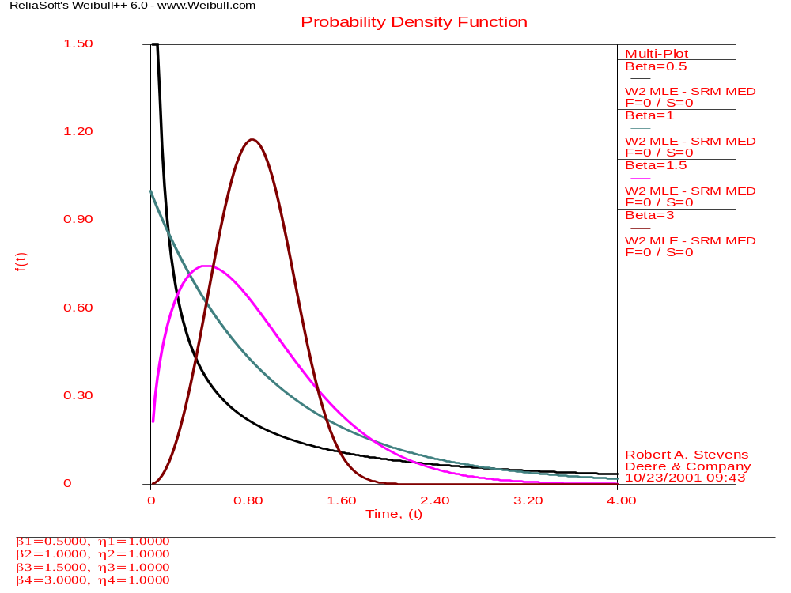




Notes:
Compare to Figure 39.2 Weibull PDF.
Weibull PDFs with Eta (η) = 1:
Beta = 3.0 – rapid wearout (note: this looks like a Normal distribution, but it’s not: for Weibull, all values are > 0; for Normal values can be positive or negative)
Beta = 1.5 – moderate wearout
Beta = 1.0 – random failures
Beta = 0.5 – infant mortality

Slide 4
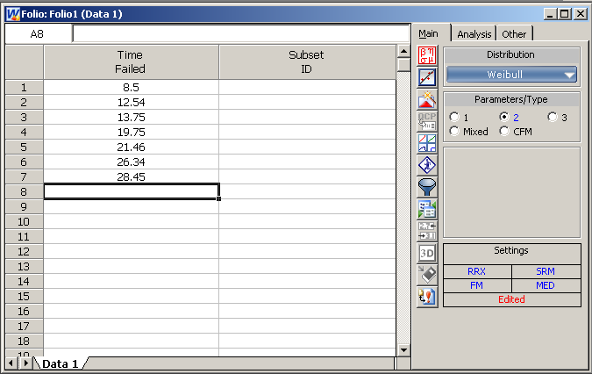
Notes:
Example 41.1: Weibull Probability Plot for Failure Data
“Seven printwheel components were tested and failed with the following number of months of usage: 8.5, 12.54, 13.75, 19.75, 21.46, 26.34, and 28.45.”
Just enter the data in Weibull++ - no need to worry about “Percentage Plot Position” anymore. Then click the Calculate button (Greek symbols) and then the Plot button.

Slide 5
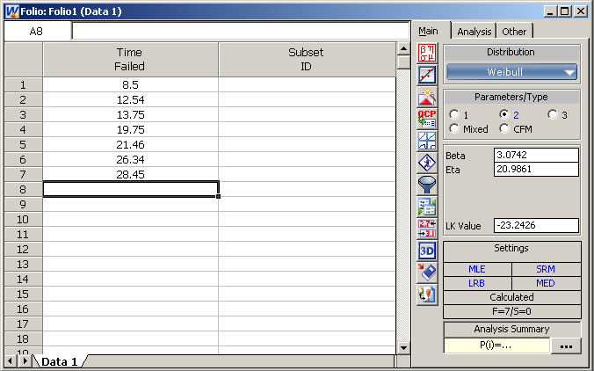
Notes:
Here’s the results of clicking the Calculate button: Beta = 3.0742 and Eta = 20.9861 (if you get different values, then you either typed in different numbers of used different Analysis settings – this was done with Analysis Method = “Maximum Likelihood (MLE)”).

Slide 6
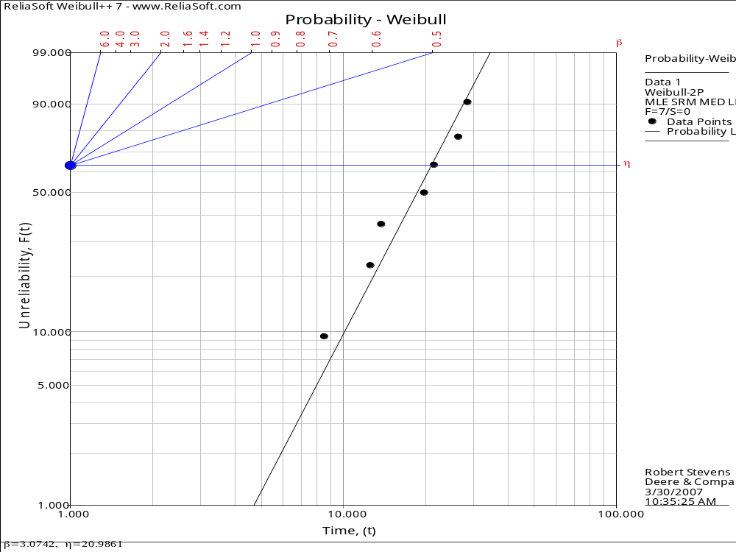
Notes:
Compare to Figure 41.1 Weibull probability plot.

Slide 7
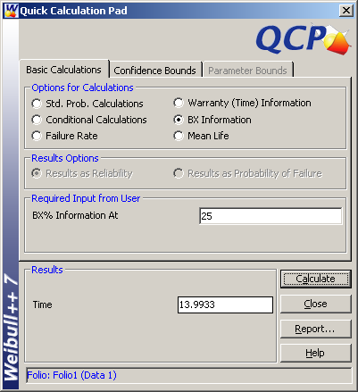
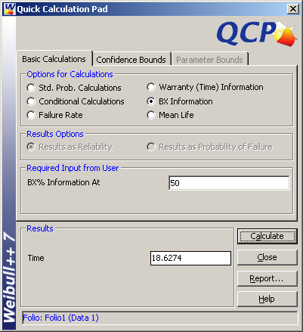
QCP Results
Notes:
The B₂₅ life is 14.0 months, and the B₅₀ life is 18.6 months. Compare to the results in the third paragraph on page 759.

Slide 8
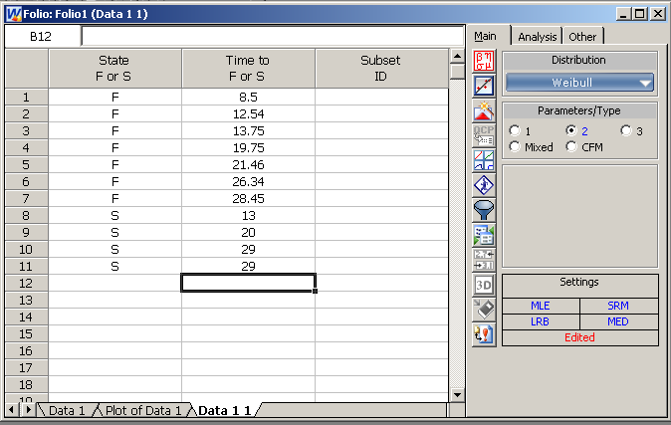
Notes:
Example 41.2: Weibull Hazard Plot with Censored Data
“Assume that the printwheel fie failure times from the preceding example also contained four censored times of 13.00, 20.00, 29.00, and 29.00 (i.e. they were taken off the test at these times).”
Censoring is indicated by an “S” in the Column “State F or S”. You need to either start with a new data sheet or modify an existing sheet to add this column (which will be covered later).

Slide 9
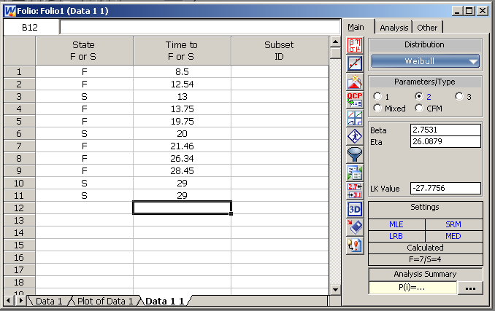
Notes:
Here’s the results of clicking the Calculate button: Beta = 2.7531 and Eta = 26.0879 (again using Analysis Method = “Maximum Likelihood (MLE)”). Before we obtained Beta = 3.0742 and Eta = 20.9861 without the censored observations.

Slide 10
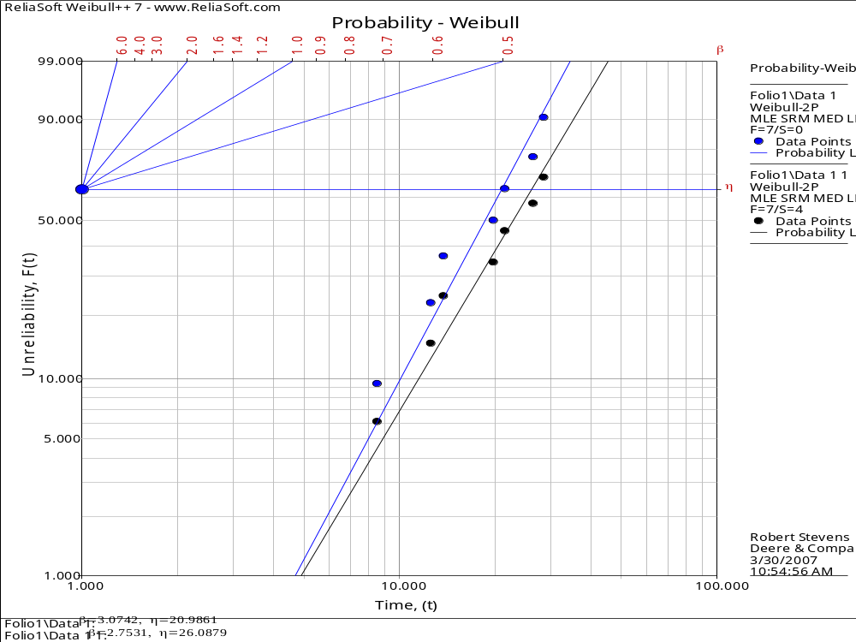
Notes:
Compare to Figure 41.2 Weibull hazard plot.
This plot shows the data from Example 41.1 and 41.2 on the same plot (by using “Insert MultiPlot Sheet” on the Folio menu). The key thing to note is that the line with the censored data is to the right of the line without the censored data. That is, you get higher reliability estimates by including censored data. Put it another way, you get falsely pessimistic reliability estimates by ignoring censored data.

Slide 11


QCP Results
Notes:
The B₂₅ life is 16.6 months, and the B₅₀ life is 22.8 months. Compare to the results in the table on page 761.

Slide 12
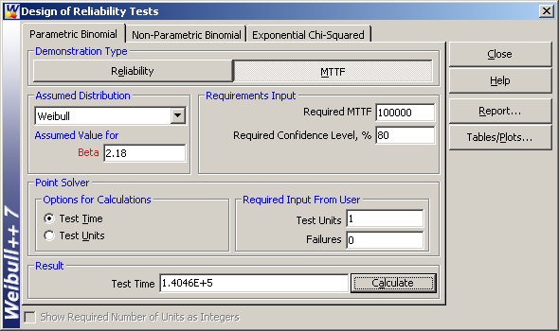
Notes:
Example 41.3: A Zero Failure Weibull Test Strategy
“A reliability test presented earlier indicated that the Weibull shape parameter was 2.18 for an automobile clutch. How long should a test consisting of 1, 2, 3, or 10 samples be tested to yield an 80% confidence bound that the mean life (T_{d}) is greater than or equal to 100,000 km of automobile usage, given that no failures occur?”
Use “Design of Reliability Tests” on the Tools menu. Based on these inputs, the answer is 140,460 for N = 1 (the book gives 140,447, so there’s probably some rounding error with that answer).
You can enter the other values of N = 2, 3, and 10 to get the other answers or make a plot of many combinations using the “Tables/Plots” button.

Slide 13
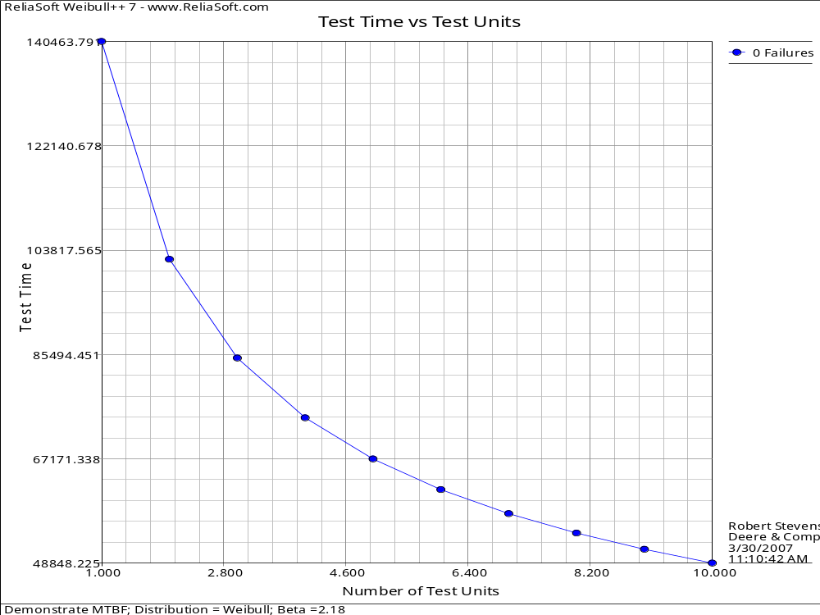
Notes:
This plot used:
Test Units: Start = 1, End = 10, Incr = 1
Failures: Start = 0, End = 0, Incr = 0
You can read off the actual value on the “Results” tab.
The important thing to note is that you can either test less parts for more time or more parts for less time, but you can’t do both. Also, the relationship is nonlinear. You cannot reduce the sample size by some about and increase the test time by the same proportion and expect to demonstrate your goals.

Slide 14
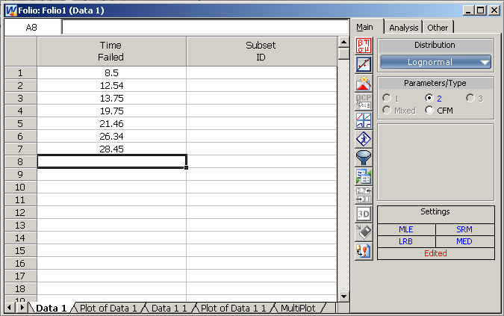
Notes:
Example 41.4: Lognormal Probability Plot Analysis
“The noncensored printwheel failure times (i.e. 8.5, 12.54, 13.75, 19.75, 21.46, 26.34, and 28.45) that were presented above will now be analyzed using lognormal probability plotting techniques.”
Just change the Distribution from Weibull to Lognormal and click Calculate.

Slide 15
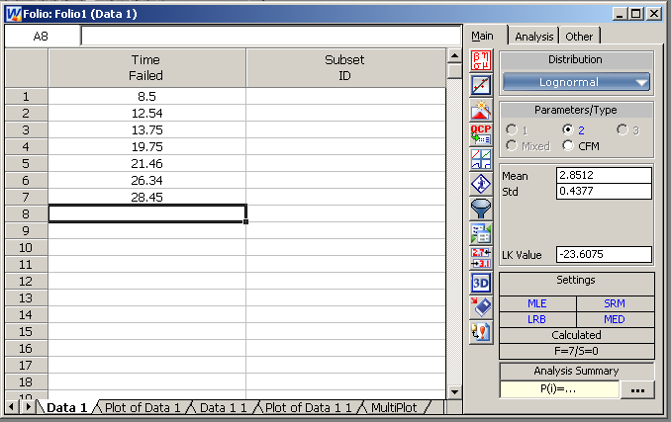
Notes:
Here’s the results of clicking the Calculate button: Mean = 2.8512 and Sdt = 0.4377 (again using Analysis Method = “Maximum Likelihood (MLE)”). Before we obtained Weibull Beta = 3.0742 and Eta = 20.9861 with the same data.

Slide 16
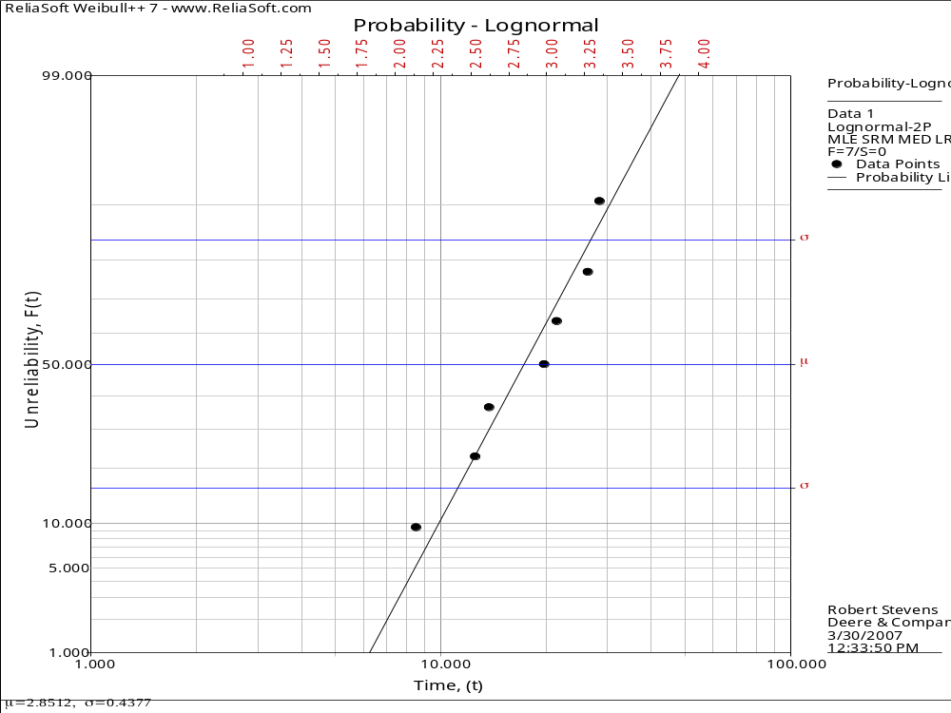
Notes:
Compare to Figure 41.4 Lognormal probability plot.

Slide 17
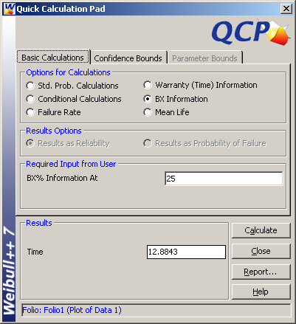
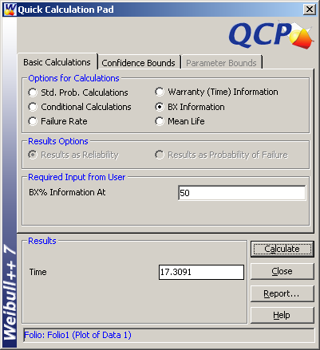
QCP Results
Notes:
The B₂₅ life is 12.9 months, and the B₅₀ life is 17.3 months. Compare to the results in the table on page 768.

Slide 18
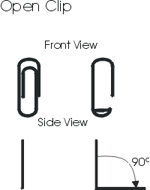
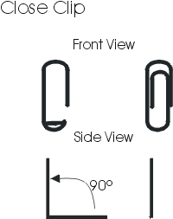
Weibull Data and Analysis Demonstration
Notes:
Hold the clip by the longer, outer loop.
With the thumb and forefinger of the other hand, grasp the smaller, inner loop.
Pull the smaller, inner loop out and down 90° so that a right angle is formed as shown.
Continue to hold the clip by the longer, outer loop.
With the thumb and forefinger of the other hand, grasp the smaller, inner loop.
Push the smaller, inner loop up and in 90° so that the smaller loop is returned to the original upright position in line with the larger, outer loop as shown.
http://www.reliasoft.com/newsletter/1q2001/accelerated.htm

